Slide 1

Sesi 7 Talking About Family English
DIAN METHA ARIYANTI/ 2022

Slide 2
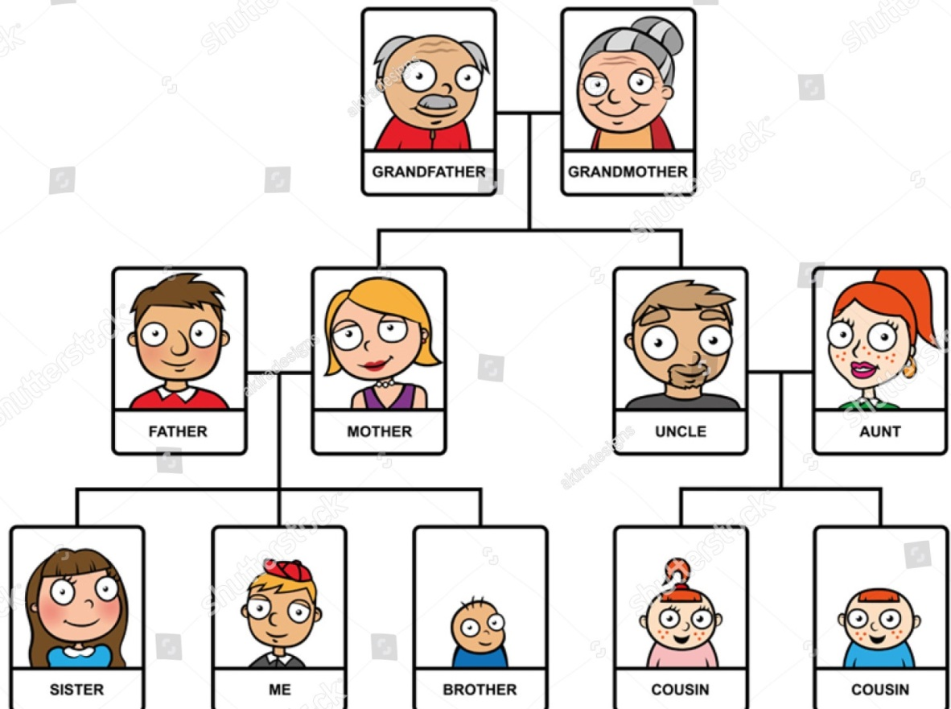
Family Tree
Immediate Family (Keluarga Terdekat)
Consist of Parents, Siblings, and Grandparents.
Grandfather (Kakek) – your mother or father’s father
Grandmother (Nenek) – your mother or father’s mother
Father (Ayah) – your male parent
Mother (Ibu) – your female parent
Brother (Saudara Laki-Laki) – a boy who has the same parents as you
Sister (Saudara Perempuan) – a girl who has the same parents as you
Husband (Suami)
Wife (Istri)
Daughter (Anak perempuan)
Son (Anak Laki-Laki)
Your Father is your Grandmother’s Son
Your Sister is your Father’s Daughter
You are your Mom’s Daughter/Son

Slide 3
Maybe your parents are no longer married to each other and start a new life.
If your dad marries someone else, his new wife will be your step-mother
If your mom remarries, her new husband will be your step-father
The children your step-mother or step-father already have will then become your step-brothers and step-sisters.
Half brother - a brother related through one parent only
Half sister - a brother related through one parent only
https://learnenglishteens.britishcouncil.org/skills/speaking/pre-intermediate-a2/talking-about-your-family

Slide 4
Extended family (Keluarga Besar)
Consist of anyone else you might be related to
Aunt (Bibi/Tante) – your mother or father’s sister
Uncle (Paman/Om) – your mother or father’s brother
Cousin (Sepupu) – the child of your aunt or uncle
Nephew (Keponakan laki-laki) – the son of your brother or sister
Niece (Keponakan Perempuan) – the daughter of your brother or sister
Your Uncle is your Grandfather’s Son
Your Niece is your Brother’s Daughter
Family by marriage
When you get married, you take on your spouse’s family. These people are known as your “in-laws.”
Brother-in-law (Saudara ipar Laki-Laki) – a man who marries your sibling
Sister-in-law (Saudara ipar Perempuan) – a woman who marries your sibling
Father-in-law (Ayah mertua) – the father of your spouse (pasangan)
Mother-in-law (Ibu mertua) – the mother of your spouse (pasangan)
Your Sister’s husband is your Brother-in-law
Your Husband’s Mother is your Mother-in-law

Slide 5
Things to Say about Family
Brief facts about your family (how many people, a large or small family)
How many people are there in your family? And who are these people?
There are ___ people in my family, (you can mention your family members)
I come from a small family. There are just __ of us, (you can mention your family members)
My family is big. There are ___ of us, (you can mention your family members)
Contoh paragraph:
I come from a big family. There are 7 people in my family. My family members are my Mother, Father, older Brother, Sister-in-law, Niece, Me, and younger Sister. I have one older brother and one younger sister. My Brother is already married, so I have one Sister-in-law. They have one daughter, she is my Niece. Her name is Sarah.

Slide 6
The names of each family member and how they are related to you
What is your brother’s name?
What is your father’s name?
My father’s name is ___
He is ___
Who is she?
She’s my Niece, my brother’s daughter. Her name is ____
Contoh paragraph:
I have one Niece. Her name is Sarah. Sarah’s Father is my Brother. Her name is Jackson. Jackson married Julia, so Julia is my Sister-in-law. They live in Jakarta with Me and my Parents.

Slide 7
Appearance and personality (Penampilan dan Kepribadian)
What does your brother look like? What does he look like?
He has ___
He is ____
His hair is ___
His eyes is ___
Contoh paragraph:
I look like my Father. We both have brown eyes and black hair. I’m very different from my Mom. She is talkative, but I’m very shy.

Slide 8
What kind of relationship you have with each family member (for example, common interests or hobbies)
What are your father’s hobbies? What is your sister like?
My father’s hobby is ____
My sister’s hobbies are ___ and ____
My mother likes ____
Contoh paragraph:
My sister is a clever student. She likes staying at home and studying, but I prefer cooking and my brother enjoys playing sports. I like sports too. My brother and I often play badminton together. We sometimes go shopping together on the weekend.

Slide 9
Add other information you want like age or job.
How old is your grandmother? What does your sister do? What is her job?
My grandmother is ___ years old
My sister is a/an ____ (mention the job)
My sister’s job is ____
Contoh:
My father is 64 years old and my mother is 58 years old.
My brother is a doctor and my sister-in-law is a teacher.

Slide 10


Slide 11
Vocabulary
Kosakata | Arti
Grandfather/Grandpa | Kakek
Grandmother/Grandma | Nenek
Father/Dad/Daddy | Ayah/Bapak
Mother/Mom/Mommy | Ibu
Brother | Saudara laki-laki
Sister | Saudara perempuan
Daughter | Anak perempuan
Son | Anak laki-laki
Aunt | Bibi/tante
Uncle | Paman/om
Kosakata | Arti
Cousin | Sepupu
Nephew | Keponakan laki-laki
Niece | Keponakan perempuan
Parents | Orang tua
Grandparents | Kakek-nenek
Sibling | Saudara kandung
Spouse | Pasangan
Twin | Kembar
Husband | Suami
Wife | Istri

Slide 12
Conversation Talking about Family
https://www.youtube.com/watch?v=ceNNH_jnQz8

Slide 13
THANK YOU! Practise saying it out loud!!

